Slide 1
FIT3143
LECTURE WEEK 5
SYNCHRONIZATION, MUTEX, DEADLOCKS

Slide 2
Overview
Real Clock Synchronization Methods
Logical Clock Synchronization Techniques
Mutual Exclusion Approaches
Deadlock detection and handling
Learning outcome(s) related to this topic
Explain the fundamental principles of parallel computing architectures and algorithms (LO1)
Compare and contrast different communication and concurrency schemes (LO2)

Slide 3
Synchronisation in Distributed Systems
A Distributed System consists of a collection of distinct processes that are spatially separated and run concurrently
In systems with multiple concurrent processes, it is economical to share the system resources.
Sharing may be cooperative or competitive
Both competitive and cooperative sharing require adherence to certain rules of behavior that guarantee that correct interaction occurs.
The rules of enforcing correct interaction are implemented in the form of synchronization mechanisms.

Slide 4
Issues implementing synchronization in DS
In single CPU systems, synchronization problems such as mutual exclusion can be solved using semaphores and monitors. These methods rely on the existence of shared memory.
We cannot use semaphores and monitors in distributed systems since two processes running on different machines cannot expect to have shared memory.
Even simple matters such as determining one event happened before the other event requires careful thought.

Slide 5
Issues implementing synchronization in DS
In distributed systems, it is usually not possible or desirable to collect all the information about the system in one place and synchronization among processes is difficult due to the following features of distributed systems:
◦The relevant information is scattered among multiple machines.
◦Processes make decisions based only on local information.
◦A single point of failure in the system should be avoided.
◦No common clock or other precise global time source exists.

Slide 6
Time and Distribution: Why?
External reasons: We often want to measure time accurately
For billings: How long was computer X used?
For legal reasons: When was credit card W charged?
For traceability: When did this attack occurred? Who did it?
System must be in sync with an external time reference
Usually the world time reference: UTC (Coordinated Universal Time)
Internal reasons: many distributed algorithms use time
Kerberos (authentication server) uses time-stamps
This can be used to serialise transactions in databases
This can be used to minimise updates when replicating data
System must be in sync internally
No need to be synchronised on an external time reference

Slide 7
Clock Synchronization
Time is unambiguous in a centralized system.
A process can just make a system call to know the time.
If process A asks for the current time, and a little later process B asks for the time, the value of B_time > A_time.
In a distributed system, if process A and B are on different machines, B_time may not be greater than A_time.

Slide 8
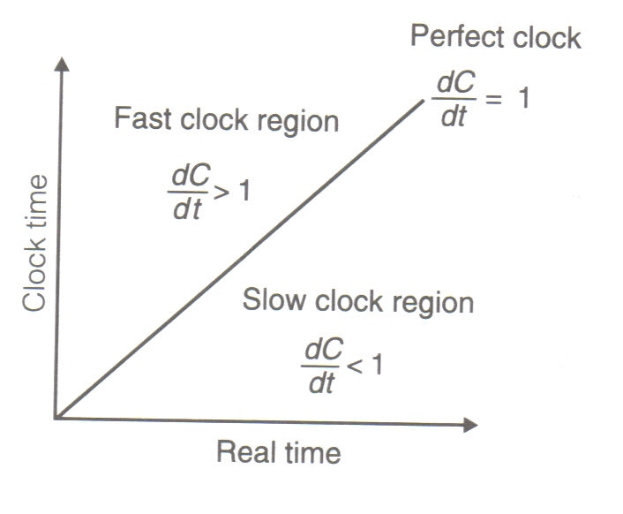
Imperfect Clocks
Human-made clocks are imperfect
They run slower or faster than “real” physical time
How much faster or slower is called the drift
A drift of 1% (i.e. 1/100=10⁻²) means the clock adds or looses a second every 100 seconds
Suppose, when the real time is t the time value
of a clock p is C_{p}(t). If the maximum drift rate
allowable is ρ, a clock is said to be non-faulty if
the following condition holds -

Slide 9

Clock Synchronisation
12:07
12:19
12:09
12:21
12:05
12:11
12:23
12:09
12:15
Let’s synchronise. I’ve got 12:07. And You?
I’ve got 12:11 Let’s agree on 12:09. OK?
Alice
Bob
OK. Done.
☹
Done.
☹

Slide 10
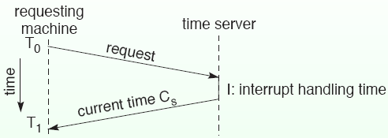
Cristian’s Algorithm
This algorithm synchronizes clocks of all other machines to the clock of one machine, time server.
If the clock of the time server is adjusted to the real time, all the other machines are synchronized to the real time.
Every machine requests the current time to the time server.
The time server responds to the request as soon as possible.
The requesting machine sets its clock to C_{s} +(T1 −T0 −I)/2. In order to avoid clocks moving backward, clock adjustment must be introduced gradually.

Slide 11
The Berkeley Algorithm
Developed by Gusella and Zatti.
Unlike Cristian’s Algorithm the server process in Berkeley algorithm, called the master periodically polls other slave process.
Generally speaking the algorithm is as follows:
A master is chosen with a ring based election algorithm (Chang and Roberts algorithm).
The master polls the slaves who reply with their time in a similar way to Cristian's algorithm
The master observes the round-trip time (RTT) of the messages and estimates the time of each slave and its own.
The master then averages the clock times, ignoring any values it receives far outside the values of the others.
Instead of sending the updated current time back to the other process, the master then sends out the amount (positive or negative) that each slave must adjust its clock. This avoids further uncertainty due to RTT at the slave processes.
Everybody adjust the time.

Slide 12
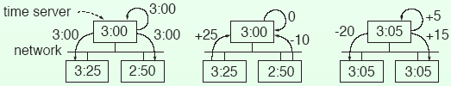
The Berkeley Algorithm
With this method the average cancels out individual clock's tendencies to drift.
Computer systems normally avoid rewinding their clock when they receive a negative clock alteration from the master. Doing so would break the property of monotonic time, which is a fundamental assumption in certain algorithms in the system itself or in some programs.
A simple solution to this problem is to halt the clock for the duration specified by the master, but this simplistic solution can also cause problems, although they are less severe. For minor corrections, most systems slow the clock (known as "clock slew"), applying the correction over a longer period of time.
2.90
2.90

Slide 13
Averaging Algorithm
Both Cristian ’s algorithm and the Berkeley algorithm are centralized algorithms with the disadvantages such as the existence of the single point of failure and high traffic volume around the server.
“Averaging algorithm” is a decentralized algorithm.
This algorithm divides time into resynchronization intervals with a fixed length R.
Every machine broadcasts the current time at the beginning of each interval according to its clock.
A machine collects all other broadcasts for a certain interval and sets the local clock by the average of their arrival times.

Slide 14
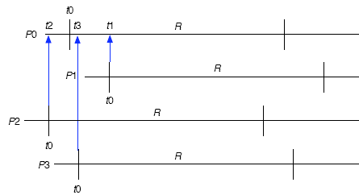
Averaging Algorithm
Clock on processor P0 should be advanced by Δt0 as below

Slide 15
Logical Clock and Physical Clock
Lamport showed
Clock synchronization need not be absolute
If two processes do not interact their clocks need not be synchronized.
What matters is they agree on the order in which events occur.
For many purposes, it is sufficient that all interacting machines agree on the same time. It is not essential that this time is the real time.
The clocks that agree among certain computers but not necessarily with the real clock are logical clocks.
Clocks that agree on time and within a certain time limit, are physical clocks.

Slide 16
Lamport’s Synchronization Algorithm
This algorithm only determines event order, but does not synchronize clocks.
“Happens-before” relation:
“A →B” is read “A happens before B”: This means that all processes agree that event A occurs before event B.
The happens-before relation can be observed directly in two situations:
If A and B are events in the same process, and A occurs before B, then A→B.
If A is the event of a message being sent by one process, and B is the event of the message being received by another process, then A→B .
“Happens-before” is a transitive relation.

Slide 17
Lamport’s Synchronization Algorithm
If two events, X and Y happen in different processes that do not exchange messages (not even indirectly via third parties), then neither X →Y nor Y →X is true. These events are “concurrent. ”
What we need is a way to assign a time value C(A) on which all processes agree for every event A. The time value must have the following properties:
◦If A →B, then C(A) < C(B).
◦The clock time must always go forward, never backward.
Suppose there are three processes which run on different machines as in the following figure. Each processor has its own local clock. The rates of the local clocks are different.

Slide 18
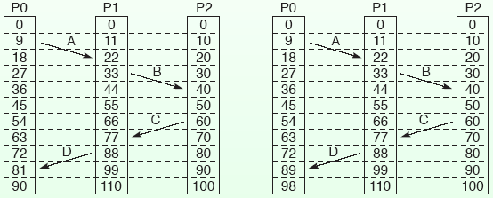
Lamport’s Synchronization Algorithm
By setting the clocks as below, we can define total ordering of all events.
If event A happens before event B within the same process, C(A) < C(B) is satisfied.
If event A and event B represent the sending and receiving of a message, the clock of the receiving side is set so that C(A) < C(B).
For all events, the clock is increased at least by 1 between two events .
Notes:
[Ref Wikipedia: Lamport Timestamps]
1. A process increments its counter before each event in that process;
2. When a process sends a message, it includes its counter value with the message;
3. On receiving a message, the receiver process sets its counter to be greater than the maximum of its own value and the received value before it considers the message received.
[Note Event D at P0 on left fig requires a local clock update under condition 3]

Slide 19
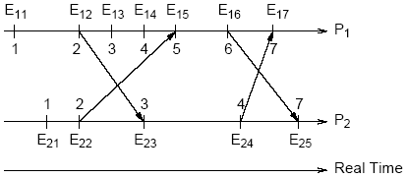
Shortcoming of Lamport’s clock
Lamport’s clock observes if a→b then C(a)<C(b) but C(a) < C(b) does not imply a→b always. Hence, we cannot deduce causal dependencies from time stamps.
The root of the problem is that clocks advance independently or via messages, but there is no history as to where the advance comes from.
In this figure,
E₁₂→E₂₃ implies C₁(E₁₂)<C₂(E₂₃)
However we may have
while C₁(E₁₃)<C₂(E₂₄)
In some situations (e.g., to implement distributed locks), a partial ordering on events is not sufficient and a total ordering is required.
Notes:
Additional note for the figure:
E_13 and E_24 are on two separate processes
E_13 and E_24 do no exchange a message
By definition (slide 17 point 1): E_13 is concurrent with E_24 (even though the clocks suggest otherwise)

Slide 20
Vector Clock
Each process maintains a vector clock V_{i} of size N, where N is the number of processes. The component V_{i}[j] contains the process p_{i}’s knowledge about p_{j}’s clock. Initially, we have V_{i}[j] := 0 for i, j є {1, 2, …, N}
Clocks are advanced as follows:
1. Before p_{i} timestamps an event, it executes V_{i}[i] = V_{i}[i] + 1.
2. Whenever a message m is sent from p_{i} to p_{j} :
• Process p_{i} executes V_{i}[i] := V_{i}[i] + 1 and sends V_{i} with m.
• Process p_{j} receives V_{i} with m and merges the vector clocks V_{i} and V_{j} as follows:
Vj [k] := {
This last part ensures that everything that subsequently happens at p_{j} is now causally related to everything that previously happened at p_{i}.
Max(V_{j}[k], V_{i}[k])+1 , if j=k (as in scalar clocks)
Max(V_{j}[k], V_{i}[k]) , otherwise

Slide 21
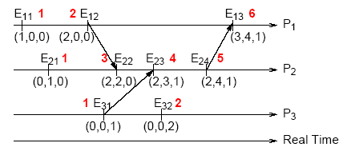
Vector Clock
Each event is annotated with both its vector clock value (the triple) and the corresponding value of a scalar Lamport clock (Red color).
For C₁(E₁₂) and C₃(E₃₂), we have 2 = 2 versus (2, 0, 0) ≠ (0, 0, 2). Likewise we have C₂(E₂₄) > C₃(E₃₂) but (2, 4, 1) NOT> (0, 0, 2) and thus E₃₂ NOT→E₂₄
Notes:
If events are not causally related then their vector clock will differ even when their scalar clock are the same.

Slide 22
Mutual exclusion in DS
When multiple processes access shared resources, using the concept of critical sections is a relatively easy way to program access of the shared resources.
Critical section is a section in a program that accesses shared resources.
A process enters a critical section before accessing the shared resource to ensure that no other process will use the shared resource at the same time.
• Critical sections are protected using semaphores and monitors in single-processor systems. We cannot use these mechanisms in distributed systems.

Slide 23
A Centralized Algorithm
This algorithm simulates mutual exclusion in single processor systems.
One process is elected as the coordinator.
When a process wants to enter a critical section, it sends a request to the coordinator stating which critical section it wants to enter.
If no other process is currently in that critical section, the coordinator returns a reply granting permission.
If a different process is already in the critical section, the coordinator queues the request.
When the process exits the critical section, the process sends a message to the coordinator releasing its exclusive access.
The coordinator takes the first item off the queue of deferred request and sends that process a grant message.

Slide 24
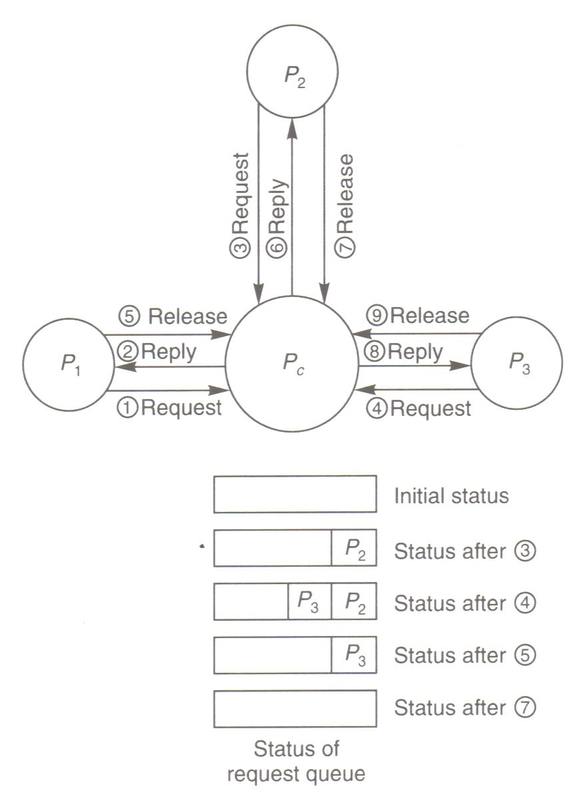
A Centralized Algorithm

Slide 25
A Centralized Algorithm
Advantages
◦Since the service policy is first-come first-serve, it is fair and no process waits forever.
◦It is easy to implement.
◦It requires only three messages, request, grant, and release, per use of a critical section.
Disadvantages
◦If the coordinator crashes, the entire system may go down.
◦Processes cannot distinguish a dead coordinator from “permission denied.”
◦A single coordinator may become a performance bottleneck.

Slide 26
A Distributed Algorithm
The distributed algorithm proposed by Ricart and Agrawala requires ordering of all events in the system. We can use the Lamport’s algorithm for the ordering.
When a process wants to enter a critical section, the process sends a request message to all other processes. The request message includes
Name of the critical section
Process number
Current time
The other processes receive the request message.
If the process is not in the requested critical section and also has not sent a request message for the same critical section, it returns an OK message to the requesting process.
If the process is in the critical section, it does not return any response and puts the request to the end of a queue.
If the process has sent out a request message for the same critical section, it compares the time stamps of the sent request message and the received message.

Slide 27
A Distributed Algorithm
If the time stamp of the received message is smaller than the one of the sent message, the process returns an OK message.
If the time stamp of the received message is larger than the one of the sent message, the request message is put into the queue.
The requesting process waits until all processes return OK messages.
When the requesting process receives all OK messages, the process enters the critical section.
When a process exits from a critical section, it returns OK messages to all requests in the queue corresponding to the critical section and removes the requests from the queue.
Processes enter a critical section in time stamp order using this algorithm.

Slide 28
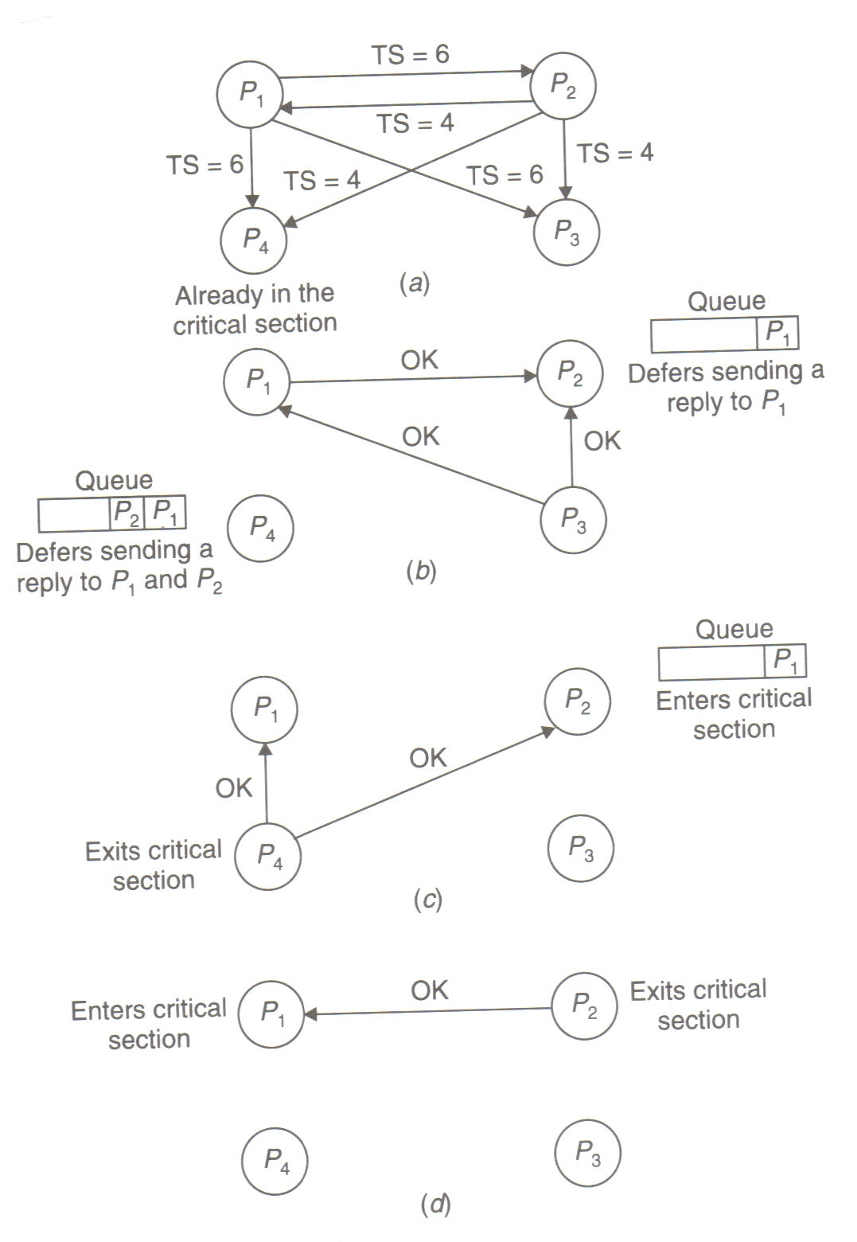
A Distributed Algorithm

Slide 29
A Distributed Algorithm
Advantage
◦No deadlock or starvation happens.
Disadvantages
◦2(n − 1) messages are required to enter a critical section. Here n is the number of processes.
◦If one of the processes fails, the process does not respond to the request. It means no process can enter the critical section.
◦The coordinator is the bottleneck in a centralized system. Since all processes send requests to all other processes in this distributed algorithm, all processes are bottlenecks in this algorithm.

Slide 30
Token Ring Algorithm
We can construct a virtual ring by assigning a sequence number to processes.
◦Processes can form a virtual ring even if the processes are not physically connected in a ring shape. The process #0 receives a token when the ring is initialized.
The token is passed to the process with the next sequence number.
A process can enter the critical section only if the process holds the corresponding token. The process passes the token to the next process when it is done.
A process passes the received token if it needs not to enter the critical section upon receiving the token.

Slide 31
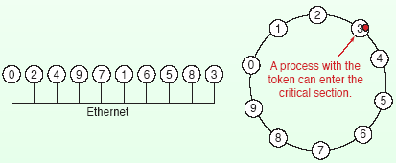
Token Ring Algorithm
Advantage
◦Processes don’t suffer from starvation. Before entering a critical section, a process waits at most for the duration that all other processes enter and exit the critical section.
Disadvantages
If a token is lost for some reasons, another token must be generated.
Detecting lost token is difficult since there is no upper bound in the time a token takes to rotate the ring.
The ring must be reconstructed when a process crashes.

Slide 32
Mutual Exclusion Algorithm: A Comparison
Messages Exchanged (Messages per entry/exit of critical section)
• Centralized: 3
• Distributed: 2(n − 1)
• Ring: 2
Reliability (Problems that may occur)
• Centralized: coordinator crashes
• Distributed: any process crashes
• Ring: lost token, process crashes

Slide 33
Group Mutual Exclusion
In the group mutual exclusion problem, which generalizes mutual exclusion, processes choose ‘session’ when they want entry to the Critical Section (CS); processes are allowed to be in the CS simultaneously provided they request the same session.
Processes
Critical
Section
CD
1
P
1
(
X
)
CD
2
(
Y
)
P
2
Sessions
CD
3
CD Loader
(
Z
)
CD
4
(
P
)
Pn
CD
5
(
Q
)

Slide 34
Applications of GME
In some applications such as Computer Supported Cooperative Work (CSCW)
Wireless application
An efficient GME solution could also help improve the quality of services of an Internet server. The GME protocol can be used to group different requests for the same service, and thereby, reduce the memory swapping.

Slide 35
Deadlocks in Distributed Systems
A deadlock is a condition where a process cannot proceed because it needs to obtain a resource held by another process and it itself is holding a resource that the other process needs.
We can consider two types of deadlock:
communication deadlock occurs when process A is trying to send a message to process B, which is trying to send a message to process C which is trying to send a message to A.
A resource deadlock occurs when processes are trying to get exclusive access to devices, files, locks, servers, or other resources.
We will not differentiate between these types since we can consider communication channels to be resources without loss of generality.

Slide 36
Necessary conditions for Deadlock
Four conditions have to be met for deadlock to be present:
Mutual exclusion. A resource can be held by at most one process
Hold and wait. Processes that already hold resources can wait for another resource.
Non-preemption. A resource, once granted, cannot be taken away from a process.
Circular wait. Two or more processes are waiting for resources held by one of the other processes.

Slide 37
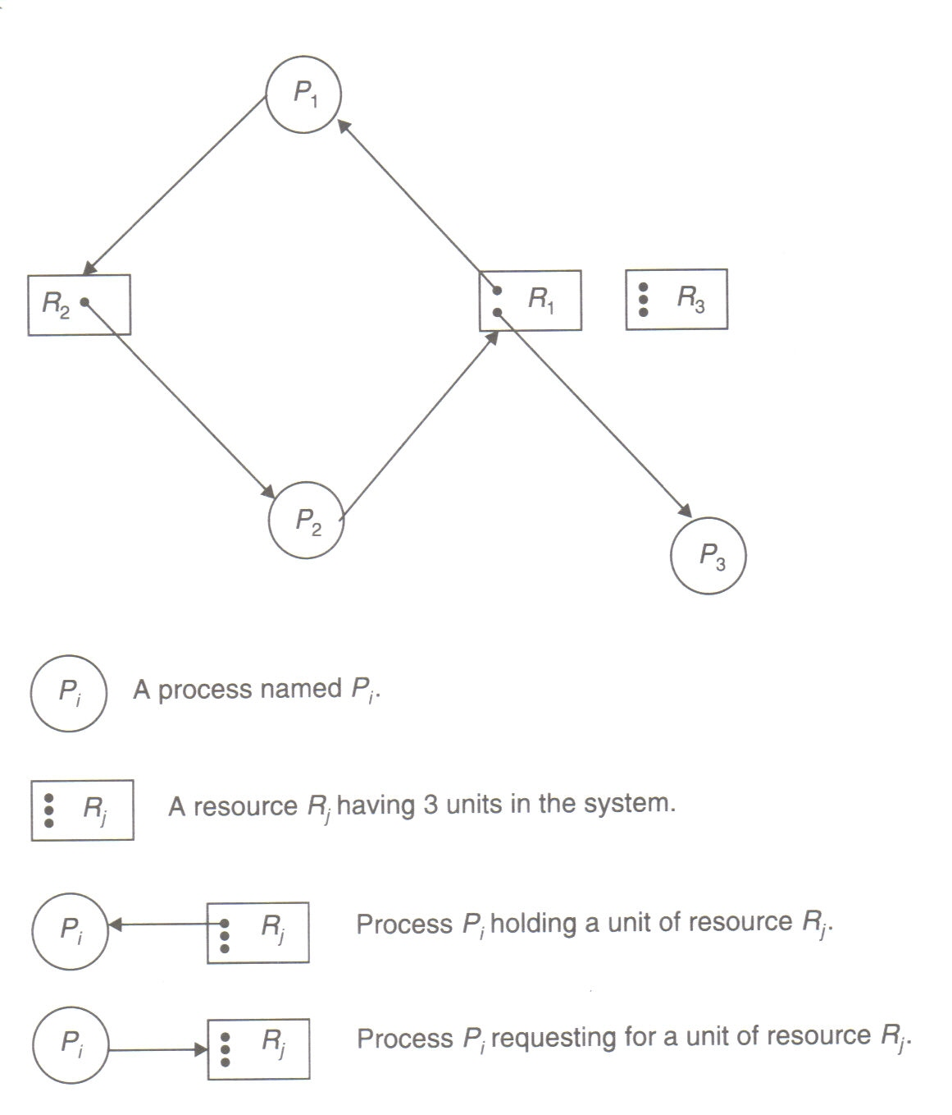
Deadlock Modeling
For deadlock modeling, a directed graph, called a resource allocation graph, is used in which both the sets
of nodes and edges are partitioned
into two types, resulting in following graph elements-
Process nodes: P₁, P₂, P₃
Resource nodes: R₁, R₂, R₃
Assignment edges: (R₁, P₁), (R₁, P₃)
Request edges: (P₁, R₂), (P₂, R₁)

Slide 38
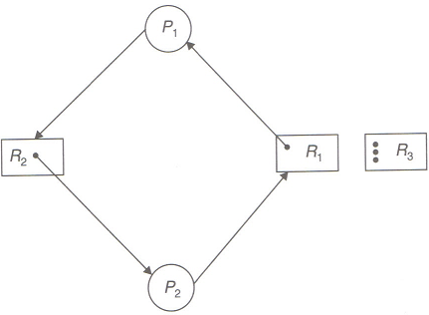
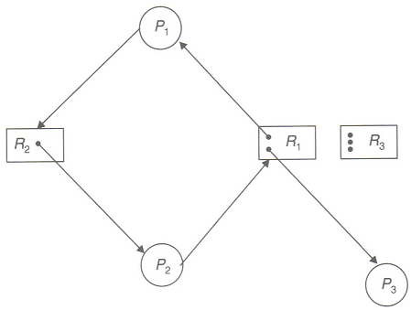
Necessary Conditions for Deadlock
In resource allocation graph, a cycle is a necessary condition for a deadlock to exist.
It is a Deadlock
But this is not

Slide 39


Sufficient condition for a deadlock
If there is only one copy of all resources
A Cycle in resource allocation graph
If there are multiple copies of some resources
A Knot in resource allocation graph
Note-
A knot in a directed graph is a collection of vertices and edges with the property that every vertex in the knot has outgoing edges, and all outgoing edges from vertices in the knot terminate at other vertices in the knot.

Slide 40
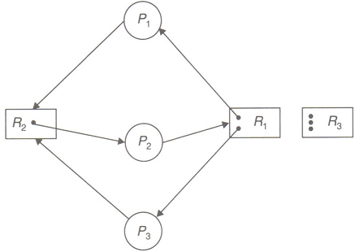
Sufficient condition for a deadlock
Cycles:
1. (P₁, R₂, P₂, R₁, P₁)
2. (P₃, R₂, P₂, R₁, P₃)
Knot:
1. {P₁, P₂, P₃, R₁, R₂}
Thus here is a deadlock !

Slide 41
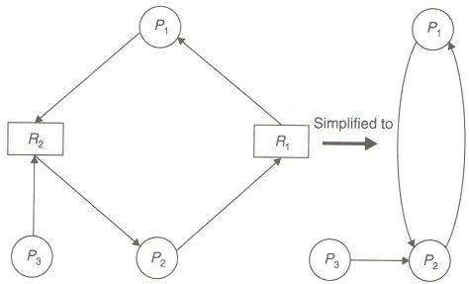
Wait for Graph
When all resource types have only a single unit each, a simplified form of resource allocation graph is used – wait-for graph.
Wait-for graph may be constructed from resource allocation graph by removing the resource nodes and collapsing the appropriate edges.

Slide 42
Handling deadlocks in DS
Strategies
– Ostrich algorithm
– Deadlock detection and recovery
– Deadlock prevention by careful resource allocations
– Deadlock avoidance by designing the system in such a way that deadlocks become impossible to occur

Slide 43


Ostrich Algorithm
Ignore the deadlock problem

Slide 44
Deadlock Detection in DS
Preventing or avoiding deadlocks can be difficult.
Detecting them is easier.
When deadlock is detected
kill off one or more processes
annoyed users
if system is based on atomic transactions, abort one or more transactions
transactions have been designed to withstand being aborted
system restored to state before transaction began
transaction can start a second time
resource allocation in system may be different so the transaction may succeed
Notes:
Reset transaction (if atomic)

Slide 45
Centralized deadlock detection Algorithm
Imitate the non-distributed algorithm through a coordinator
Each machine maintains a resource graph for its processes and resources
A central coordinator maintains a graph for the entire system
message can be sent to coordinator each time an arc is added or deleted
list of arc adds/deletes can be sent periodically

Slide 46
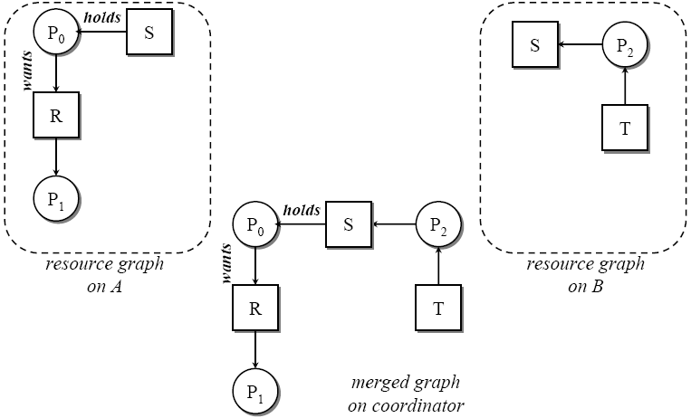
Centralized deadlock detection Algorithm

Slide 47
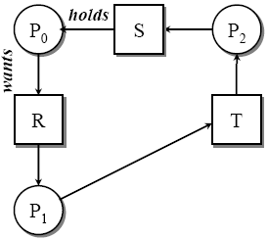
False Deadlock by Centralized Algorithm
Two events occur:
1. Process P1 releases resource R
2. Process P1 asks machine B for resource T
Two messages are sent to the coordinator:
1 (from A): releasing R
2 (from B): waiting for T
If message 2 arrives first, the coordinator constructs
a graph that has a cycle and hence detects a
deadlock. This is false deadlock.
Global time ordering must be imposed on all machines or
Coordinator can reliably ask each machine whether it has any release messages.
A
B

Slide 48
A Distributed Approach
Proposed by Chandy, Misra and Haas.
Processes can requests multiple resources at once
Some processes wait for local resources
Some processes wait for resources on other machines
Algorithm invoked when a process has to wait for a resource
A probe message is generated. This message contains 3 fields-
process that just blocked
process sending the message
process to whom it is being sent

Slide 49
Chandy-Misra-Haas Algorithm
when probe message arrives, recipient checks to see if it is waiting for any processes
If no, ignore the message
If so, update message
replace second field by its own process number
replace third field by the number of the process it is waiting for
send messages to each process on which it is blocked
If a message goes all the way around and comes back to the original sender, a cycle exists
That means, we have deadlock

Slide 50
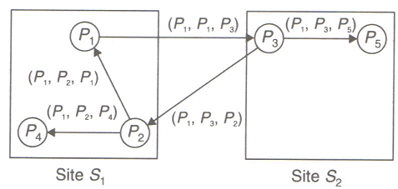
CMH Algorithm
Suppose,
P₁ gets blocked by P₃
P₃ gets blocked by P₂ and P₅
P₂ gets blocked by P₁ and P₄

Slide 51
Recovery after Detection
One of the following methods may be used
Asking for operator intervention
Terminating of process(es)
Rollback of process(es)
Issues in recovery from deadlock
Minimization of recovery cost
Prevention of starvation

Slide 52
Deadlock Avoidance
When a process requests a resource, even if the resource is available, it is not immediately allocated to the process. Rather, the system simply assumes that a request is granted
With the assumption made is previous step and advance knowledge of resource usage of processes, the system performs some analysis to decide whether granting the request is safe or unsafe.
The resource is allocated to the process only when the analysis of previous step shows that it I safe to do so, otherwise the request is deferred.
Although theoretically attractive, these algorithms are rarely used.

Slide 53
Deadlock prevention
Collective requests
Denies the hold-and-wait condition. Two ways-
A process must request all of its resources before it begins the execution. If all resources are granted, execution starts; otherwise the process would just wait.
Instead of requesting all its resources before, a process may request a resource during its execution if it obeys that it holds no other resources while requesting. If it is holding some resources, it may release all the resources first and then request for all.

Slide 54
Deadlock prevention
Ordered requests
Denies circular wait
All resources are numbered. If a process is holding a resource i it may request a resource having the number j only if j>i.
Preemption
Resources may by preempted away from one process and assigned to another.
Two widely used methods are wait-die and wound-wait

Slide 55
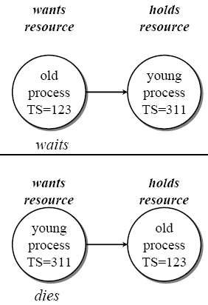
Wait-die Algorithm
Old process wants resource held by a younger process
– old process waits
Young process wants resource held by older process
– young process kills itself

Slide 56
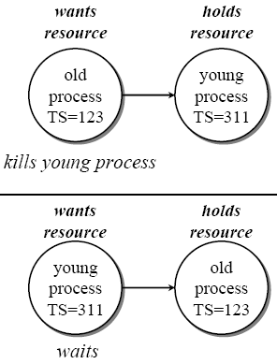
Wound-wait Algorithm
Instead of killing the transaction making the request, kill the resource owner
Old process wants resource held by a younger process
– old process kills the younger process
Young process wants resource held by older
process
– young process waits

Slide 57
Summation
Three Real Clock Synchronisation Methods?
Cristian’s Method
Berkeley Algorithm
Averaging Algorithm
Two Logical (Clock) Synchronisation Techniques
Lamport
Vector Clock
Three Mutual Exclusion Approaches?
Centralised
Distributed
GME
Main Deadlock Modeling Areas?
Necessary condition for occurrence
Deadlock Detection
Deadlock Handling

Slide 58
References
I Kuz, M Chakravarty, G Heiser, Lecture notes, University of NSW, 2010.
K. Mani Chandy and Leslie Lamport. Distributed snapshots: Determining global states of distributed systems. ACM Transactions on Computer Systems, 3:63–75, 1985.
Leslie Lamport. Time, clocks, and the ordering of events in a distributed system. Com- munications of the ACM, 21:558–565, 1978.
G. Ricart and A. Argawala. An optimal algorithm for mutual exclusion in computer networks. Communications of the ACM, 24(1), January 1981.

